Slide 1
Paper Examples

Slide 2
LocalSearch_6.csv

Slide 3
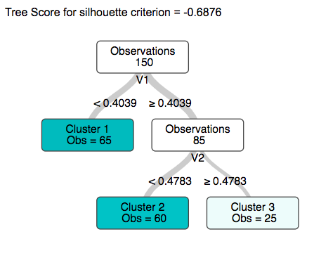
Greedy Search

Slide 4
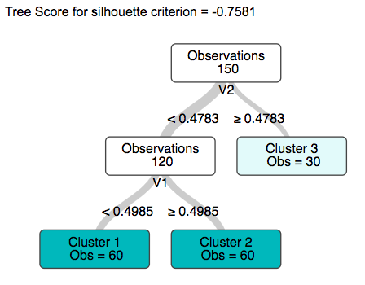
Local Search

Slide 5
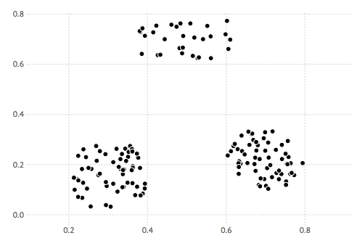
Greedy Iteration

Slide 6
Greedy Iteration

Slide 7
Greedy Iteration

Slide 8
Greedy Iteration

Slide 9
Greedy Iteration

Slide 10
Greedy Iteration

Slide 11
Greedy Iteration

Slide 12
Localsearch6

Slide 13
Localsearch6

Slide 14
Localsearch6

Slide 15
Localsearch6

